Slide 1
FUNCTIONS

Slide 2
Presentation Includes :
Introduction to functions
Types of C functions
Function naming rule in c
Three main parts of function
Categorized based on argument and return value
Passing arguments
Advantage of function
Recursive function
Macro’s in C

Slide 3
Introduction :
Function are used for divide a large code into module, due to this we can easily debug and maintain the code.
A function is a block of code which only runs when it is called. You can pass data, known as parameters, into a function.
Functions are used to perform certain actions, and they are important for reusing code: Define the code once, and use it many times.
Depending on whether a function is defined by the user or already included in C compilers, There Are Two Types Of Functions In C Programming
1.Standard library functions or pre-define function
2.User defined functions

Slide 4
Functions
Library Functions
User Defined Functions
Predefined
Created by user
Declarations inside header files
Reduced complexity of program
Eg: Printf () , scanf(0..etc

Slide 5
Function naming rule in c
A function name must begin with an alphabetic letter or the underscore _ character, but the other characters in the name can be chosen from the following groups:
Any lower-case letter from a to z
Any upper-case letter from A to Z
Any digit from 0 to 9
The underscore character
The general form of a function definition in C
return_data_type function_name(parameter list)
{
// body of the function
}

Slide 6
Parts of user-defined function in C
Function declaration return_Type function_Name(parameter1,parameter2,......);
function call function_Name(Argument list);
Function definition return_Type function_name(parameter_1, parameter_2,....)
{
//body of the function
}
Types of the user-defined function in C language
function with a return value and with an argument
function with a return value and without argument
function with no return value and with an argument
function with no return value and without argument

Slide 7
1.function with a return value and with an argument
#include<stdio.h>
int add( int , int ) ; //function declaration
int main( )
{
int a = 5 , b = 10 , result ;
result = add( a , b ) ; //function call and actual argument these are
printf( "%d" , result) ;
}
int add( int a , int b ) //function definition
{
int c ;
c = a + b ; //These are formal parameter
return c ;
}

Slide 8
2.function with a return value and without an argument
#include<stdio.h>
int add( ) ;
int main( )
{
int result ;
result = add( ) ;
printf( "%d" , result ) ;
}
int add( )
{
int a = 5 , b = 10 , c ; //no argument passing so declare and initilize here only
c = a + b ;
return c ;
}

Slide 9
3.function without a return value and with an argument
#include<stdio.h>
void add( int a , int b) ; //variable name is optional to written
int main( )
{
int a = 5 , b = 10 , result ;
add( a , b ) ;
}
void add( int a , int b )
{
int c ;
c = a + b ;
printf( "%d" , c ) ;
}

Slide 10
4.function without a return value and without an argument
#include<stdio.h>
void add( ) ;
int main( )
{
add( ) ; //function call
}
void add( )
{
int a = 5 , b = 10 , c ; //without return type and no argument pass
c = a + b ;
printf( "%d" , c ) ; //without return type so printf in userdefined function only
}

Slide 11
There are two methods to pass the data into the function in C language
1.Call by value
2.Call by reference.
Call by value in C
In call by value method, the value of the actual parameters is copied into the formal parameters. In other words, we can say that the value of the variable is used in the function call in the call by value method.
In call by value method, we can not modify the value of the actual parameter by the formal parameter.
In call by value, different memory is allocated for actual and formal parameters since the value of the actual parameter is copied into the formal parameter.
The actual parameter is the argument which is used in the function call whereas formal parameter is the argument which is used in the function definition.

Slide 12
Call By Value Flow Chart
Start
Read A
Read B
Swap(A,B)
Swap(int a , int b)
End
Temp =a
a=b
b=temp
Printf a
Printf b
Return

Slide 13
Swap two number using call by value
#include<stdio.h>
void swap( int , int ) ;
int main( ) {
int a = 10 , b = 20 ;
printf("before swap :a=%d\tb=%d\n",a,b);
swap( a , b ) ;
}
void swap(int a , int b)
{
int temp ;
temp = a ;
a = b ;
b = temp ;
printf("after swap:a=%d\tb=%d" , a , b ) ; }

Slide 14
Call by reference in C
In call by reference, the address of the variable is passed into the function call as the actual parameter.
The value of the actual parameters can be modified by changing the formal parameters since the address of the actual parameters is passed.
In call by reference, the memory allocation is similar for both formal parameters and actual parameters. All the operations in the function are performed on the value stored at the address of the actual parameters, and the modified value gets stored at the same address.

Slide 15
Call by referance flow chart
Start
int *p,*q
p=&a
q=&b
Read p
Read q
Swap(int *a , int *b)
Temp =a
a=b
b=temp
Swap(p,q)
End
Printf a
Print b
Return

Slide 16
Swap two number using call by referance
#include<stdio.h>
void swap( int * , int * ) ;
int main( )
{
int a = 5 , b = 10 ;
printf("before swap a=%d\tb=%d\n",a,b);
swap(&a , &b) ;
}
void swap(int *a , int *b)
{
int temp;
temp = *a ;
*a = *b ;
*b = temp ;
printf("%d\t%d\n" , &a , &b) ;
printf("after swap a=%d\tb=%d" , *a , *b) ;
}

Slide 17
Passing array as arguments in functions
#include<stdio.h>
int sum(int a[]); //function definition
int main()
{
int a[ ] = { 2 , 3 , 5 , 6 } , result ;
result = sum( a ) ; //function call
printf( "%d" , result ) ;
}
int sum( int a[ ] ) //function definition with return type and with argument
{
int sum = 0 , i ;
for(i=0 ; i<4 ; i++)
{
sum=sum + a[ i ];
}
return sum ;
}

Slide 18
Passing structure as an arguments in function
#include<stdio.h>
struct student
{
char name[ 20 ] ;
int age , per ;
} s1 ; //structure variable declaration
int main( )
{
gets(s1.name) ;
scanf( "%d %d" , &s1.age , &s1.per ) ; //age and percentage taking as input
display(s1.age , s1.per) ; //call function
}
void display( int a , int b ) //function definiion
{
printf( "age:%d\n per : %d " , a , b) ;
}

Slide 19
Passing pointer as an arguments in function
#include<stdio.h>
int main( )
{
int sallery , bonus , a ;
printf("enter sallery:") ;
scanf("%d",&sallery) ;
printf("enter bonus:") ;
scanf("%d",&bonus) ;
a = hike(&sallery,&bonus) ; //function calling
printf("total sallery:%d",a) ;
}
int hike(int *sallery , int *bonus) //with return type and with argument
{
return *sallery + *bonus ;
}

Slide 20
Passing string as an arguments in function
#include<stdio.h>
int main( )
{
char a[ 20 ] = "umesh" ;
fun( a ) ;
}
void fun(char *p)
{
printf( "%s" , p ) ;
}

Slide 21
Advantages of Using Functions in C Programming
It will reduce the time complexity
One of the primary achievements of the C functions is reusability.
we can call a function any place in program
can easily correct or debug the program
We can perform the tracking of a large C program pretty easily if we divide it into various functions.

Slide 22
Recursion and Macros

Slide 23
Introduction
Recursion is the process which comes into existence when a function calls a copy of itself to work on a smaller problem. Any function which calls itself is called recursive function, and such function calls are called recursive calls.
Recursion involves several numbers of recursive calls. However, it is important to impose a termination condition of recursion.
Recursion cannot be applied to all the problem, but it is more useful for the tasks that can be defined in terms of similar subtasks. For Example, recursion may be applied to sorting, searching, and traversal problems.

Slide 24
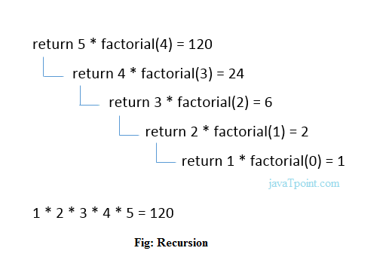
Example 1:
Calculate the factorial of a number using recursion
#include <stdio.h>
int fact (int);
int main()
{
int n,f;
printf("Enter the number whose factorial you want to calculate?");
scanf("%d",&n);
f = fact(n);
printf("factorial = %d",f);
}
int fact(int n)
{
if (n==0)
{
return 0;
}
else if ( n == 1)
{
return 1;
}
else
{
return n*fact(n-1);
}
}

Slide 25
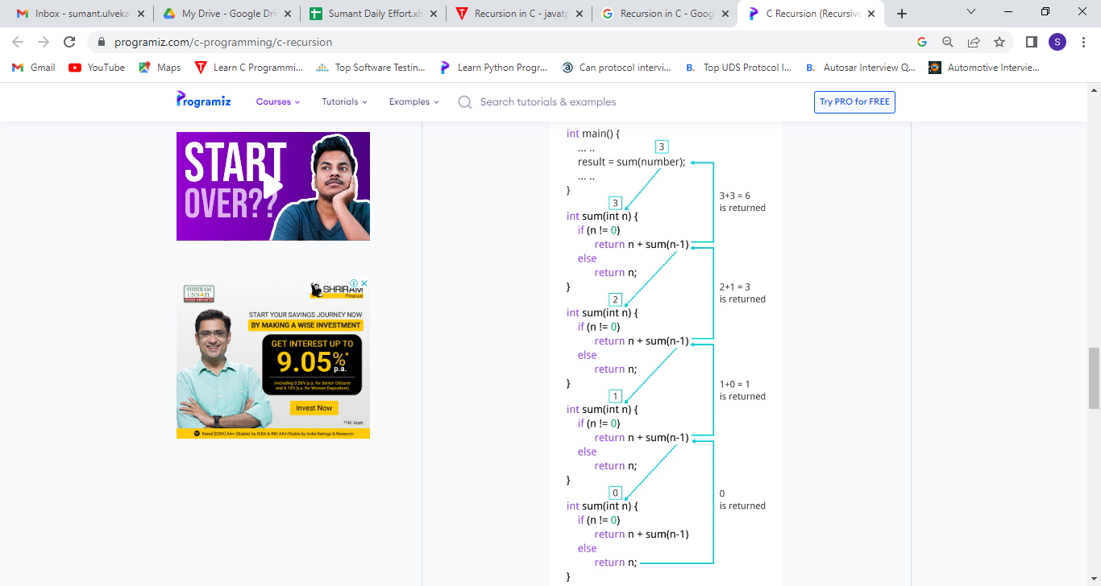
Example 2
Sum of Natural Numbers Using Recursion
#include <stdio.h>
int sum(int n);
int main( )
{
int number, result ;
printf("Enter a positive integer :");
scanf("%d", &number) ;
result = sum(number) ;
printf("sum = %d", result) ;
return 0 ;
}
int sum(int n)
{
if (n != 0)
// sum() function calls itself
return n + sum(n-1) ;
else
return n ;
}

Slide 26
Types of the recursion
1.Direct Recursion
When a function calls itself within the same function repeatedly, it is called the direct recursion.
fun( )
{
// write some code
fun( );
// some code
}

Slide 27
Example
#include<stdio.h>
int fibo_num (int i)
{
if ( i == 0)
{
return 0; // if the num i is equal to 0, return 0;
}
if ( i == 1)
{
return 1;
}
return fibo_num (i - 1) + fibonacci (i -2);
}
int main ( )
{
int i;
for ( i = 0; i < 10; i++) // use for loop to get the first 10 fibonacci series
{
printf (" %d \t ", fibo_num (i) ) ;
}
return 0;
}

Slide 28
2.Indirect Recursion
When a function is mutually called by another function in a circular manner, the function is called an indirect recursion function.
fun1()
{
// write some code
fun2()
}
fun2()
{
// write some code
fun3()
// write some code
}
fun3()
{
// write some code
fun1()
}

Slide 29
Example
#include <stdio.h>
// declaration of the odd and even() function
void odd(); // Add 1 when the function is odd()
void even(); // Subtract 1 when the function is even
int num = 1; // global variable
void odd ()
{
// if statement check and execute the block till n is less than equal to 10
if (num <= 10)
{
printf (" %d ", num + 1); // print a number by adding 1
num++; // increment by 1
even(); // invoke the even function
}
return;
}
void even ()
{
// if block check the condition that n is less than equal to 10
if ( num <= 10)
{
printf (" %d ", num - 1); // print a number by subtracting 1
num++;
odd(); // call the odd() function
}
return;
}
int main ()
{
odd(); // main call the odd() function at once
return 0;
}

Slide 30
3.Tail Recursion
A recursive function is called the tail-recursive if the function makes recursive calling itself, and that recursive call is the last statement executes by the function. After that, there is no function or statement is left to call the recursive function.

Slide 31
Example
#include <stdio.h>
void fun1( int num) // function definition
{
if (num = = 0) // if block check the condition
return;
else
printf ("\n Number is: %d", num); // print the number
return fun1 (num - 1); // recursive call at the end in the fun() function
}
int main ()
{
fun1(7); // pass 7 as integer argument
return 0;
}

Slide 32
4.Non-Tail / Head Recursion
A function is called the non-tail or head recursive if a function makes a recursive call itself, the recursive call will be the first statement in the function. It means there should be no statement or operation is called before the recursive calls.
Furthermore, the head recursive does not perform any operation at the time of recursive calling. Instead, all operations are done at the return time.

Slide 33
Example
#include <stdio.h>
void head_fun (int num)
{
if ( num > 0 )
{
// Here the head_fun() is the first statement to be called
head_fun (num -1);
printf (" %d", num);
}
}
int main ()
{
int a = 5;
printf (" Use of Non-Tail/Head Recursive function \n");
head_fun (a); // function calling
return 0;
}

Slide 34
C Macros
A macro is a segment of code which is replaced by the value of macro. Macro is defined by #define directive.
There are two types of macros:
Object-like Macros
Function-like Macros

Slide 35
1.Object-like Macros
The object-like macro is an identifier that is replaced by value. It is widely used to represent numeric constants.
For example: #define PI 3.14
Here, PI is the macro name which will be replaced by the value 3.14.

Slide 36
Example
#include <stdio.h>
#define SIDE 4
int main() {
int area;
area = SIDE*SIDE;
printf("Object Like Macros!\n");
printf("Area is: %d",area);
return 0;
}

Slide 37
2.Function-like Macros
The function-like macro looks like function call. For example:
#define MIN(a,b) ((a)<(b)?(a):(b))
Here, MIN is the macro name.

Slide 38
Example
#include <stdio.h>
#define AREA(s) (s * s) // macro with argument
int main()
{
int s1 = 10, area_of_square;
area_of_square = AREA(s1);
printf("Macros with arguments!\n");
printf("Area of square is: %d", area_of_square);
return 0;
}

Slide 39
C Predefined Macros
No. | Macro | Description
1 | _DATE_ | represents current date in "MMM DD YYYY" format.
2 | _TIME_ | represents current time in "HH:MM:SS" format.
3 | _FILE_ | represents current file name.
4 | _LINE_ | represents current line number.
5 | _STDC_ | It is defined as 1 when compiler complies with the ANSI standard.

Slide 40
Example
#include<stdio.h>
int main( )
{
printf("File :%s\n", __FILE__ ) ;
printf("Date :%s\n", __DATE__ ) ;
printf("Time :%s\n", __TIME__ ) ;
printf("Line :%d\n", __LINE__ ) ;
printf("STDC :%d\n", __STDC__ ) ;
return 0;
}

Slide 41
THANK YOU . . !

